Slide 1
IREx Quarterly Call
Bridget Swindell
Linda Tan
Study Support
System Development
Application Developer
Training
Bryce Embry
Lead Application Developer
David Crenshaw
Jason Tan
Evan Wimberly
Application Developer
Natalie Dilts
Kaysi Quarles
Emily Serdoz
Study support
Platform direction
Evaluation
Study Support
User Training
User Training
Materials Development
Special projects

Slide 2
01.20.2023 QUARTERLY CALL AGENDA
Welcome & Announcements
IREx Metrics
sIRB Roadblocks
IREx Demo & Planned Improvements
Evaluation
Training resources

Slide 3
About the IREx Quarterly Calls
hear • new • features
You’re busy.
learn • new • trends
Who’s using IREx?
share • your • voice
Give your opinion
IREx is busy.
Call in once a quarter to hear what’s new!
How are folks leveraging IREx on their sIRB studies?
Ask your questions
Express your needs

Slide 4
2023 Quarterly Calls
April 21st, 2023
July 21st, 2023
October 20th, 2023

Slide 5
2022 Year in Review

Slide 6
IREx by the Numbers
496 Studies
38 Unique sIRBs
460 Participating sites (PSites)
380 Unique PSites relying on an sIRB
2963 Reliances documented
2398 PSite approvals by an sIRB

Slide 7
Time to Lead Site Approval, by Year Approved & Risk Level

Slide 8
Overall* PSite Time to Approval
Timeframe (# Days) | N⁺ | median | min | max | standard deviation
Lead Site Approval - PSite Local Submission | 1050 | 87 | 0 | 1296 | 245
PSite Local Submission - Local Review | 1034 | 6 | 0 | 899 | 53
PSite Local Submission - IREx LC Comp | 1155 | 35 | 0 | 899 | 95
IREx LC Comp - sIRB Sub Time to submit site to sIRB | 1422 | 13 | 0 | 610 | 41
sIRB Sub - sIRB Appr | 1748 | 10 | 0 | 428 | 25
* Data from 2018 (when IREx began capturing local considerations) to 2022
+ Not all data points were required prior to 2022 and data resulting in negative times were discarded (e.g., local review prior to overall study approval)

Slide 9
Median Time from Lead Site Approval to PSite Approval by the sIRB
sIRB review of PSite
PSite documentation complete to sIRB Submission
Local HRPP Submission to reliance and LC documentation complete
Local HRPP Submission to Review
Lead site approval to PSite submission to Local HRPP

Slide 10
Median Time from Lead Site Approval to PSite Approval by the sIRB
sIRB submission to approval is stable (and quick!)

Slide 11
Median Time from Lead Site Approval to PSite Approval by the sIRB
Local HRPP processes involve more than HRPP review
1) HRPP must indicate reliance 2) HRPP and Study team complete local considerations questionnaire
Local HRPP submission to approval is stable, if not improving (and quick!)

Slide 12
Median Time from Lead Site Approval to PSite Approval by the sIRB
Huge improvement over 5 years!
Is there more we can do?!

Slide 13
IREx Support for Lead Study Teams – Current
Lead study team training on the sIRB process & using IREx
Study-wide training for PSite Coordinators on the sIRB process & IREx
Dashboards displaying site progress
Study-specific emails with tailored suggestions for helping sites
Reliance instruction template

Slide 14
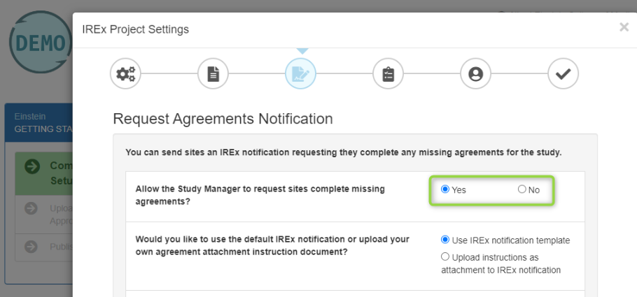
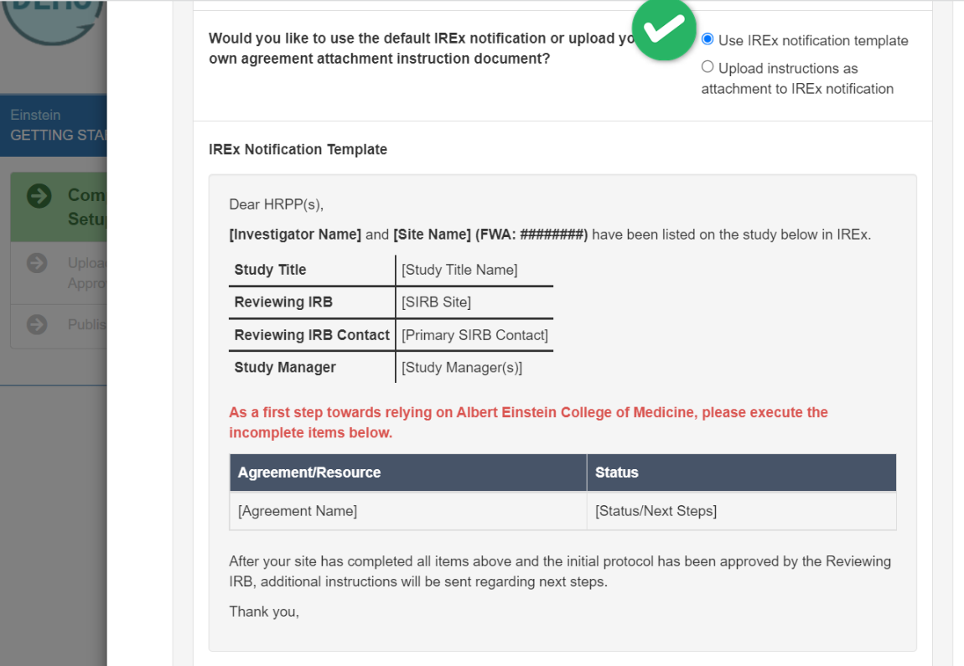
IREx Support for Lead Study Teams – Coming Soon!
Request sites complete agreements from IREx
“Request agreement” notification provided for sites missing agreements or needing to join IREx
Option to use IREx template or upload sIRB’s preferred language
Available while lead site is under review by the sIRB
Option to allow the lead study team to send the notification or keep this as an sIRB task

Slide 15
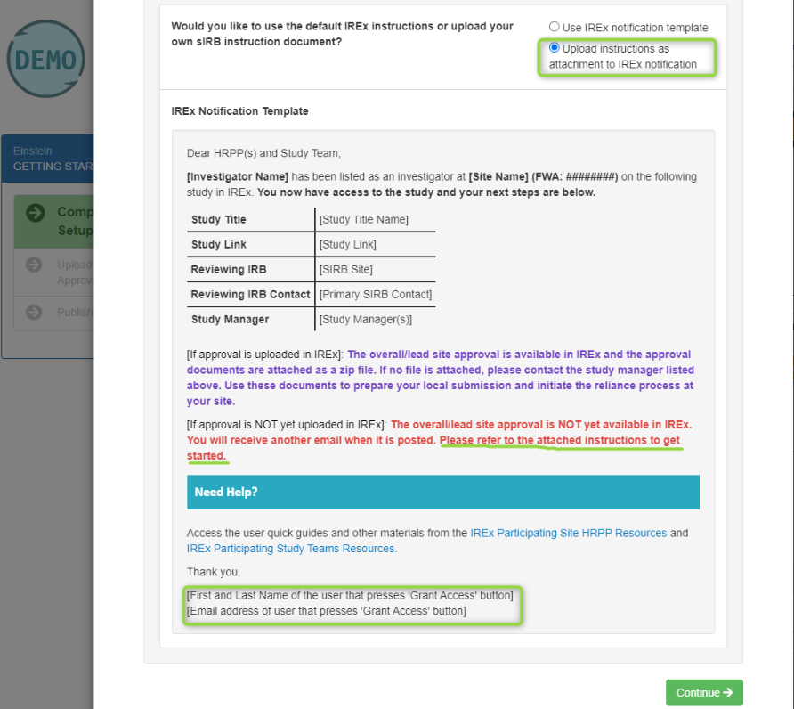
IREx Support for Lead Study Teams – Coming Soon!
Improve instructions to PSites!
Integrated reliance/sIRB instructions
Dynamically fills site-specific information such as agreement status, sIRB contact, lead study team contact, and PSite investigator
Option to upload the sIRB’s preferred instructions instead

Slide 16
IREx Support for Lead Study Teams – Coming Soon!
Grant study team access EARLIER!
Notify HRPP will now be “Grant Access”
Grant study teams access to IREx earlier – without requiring their HRPP to register
Allows immediate access to the initially approved documents to prepare their local submission
Reduces need for lead study team to manually distribute the lead approval documents by email

Slide 17
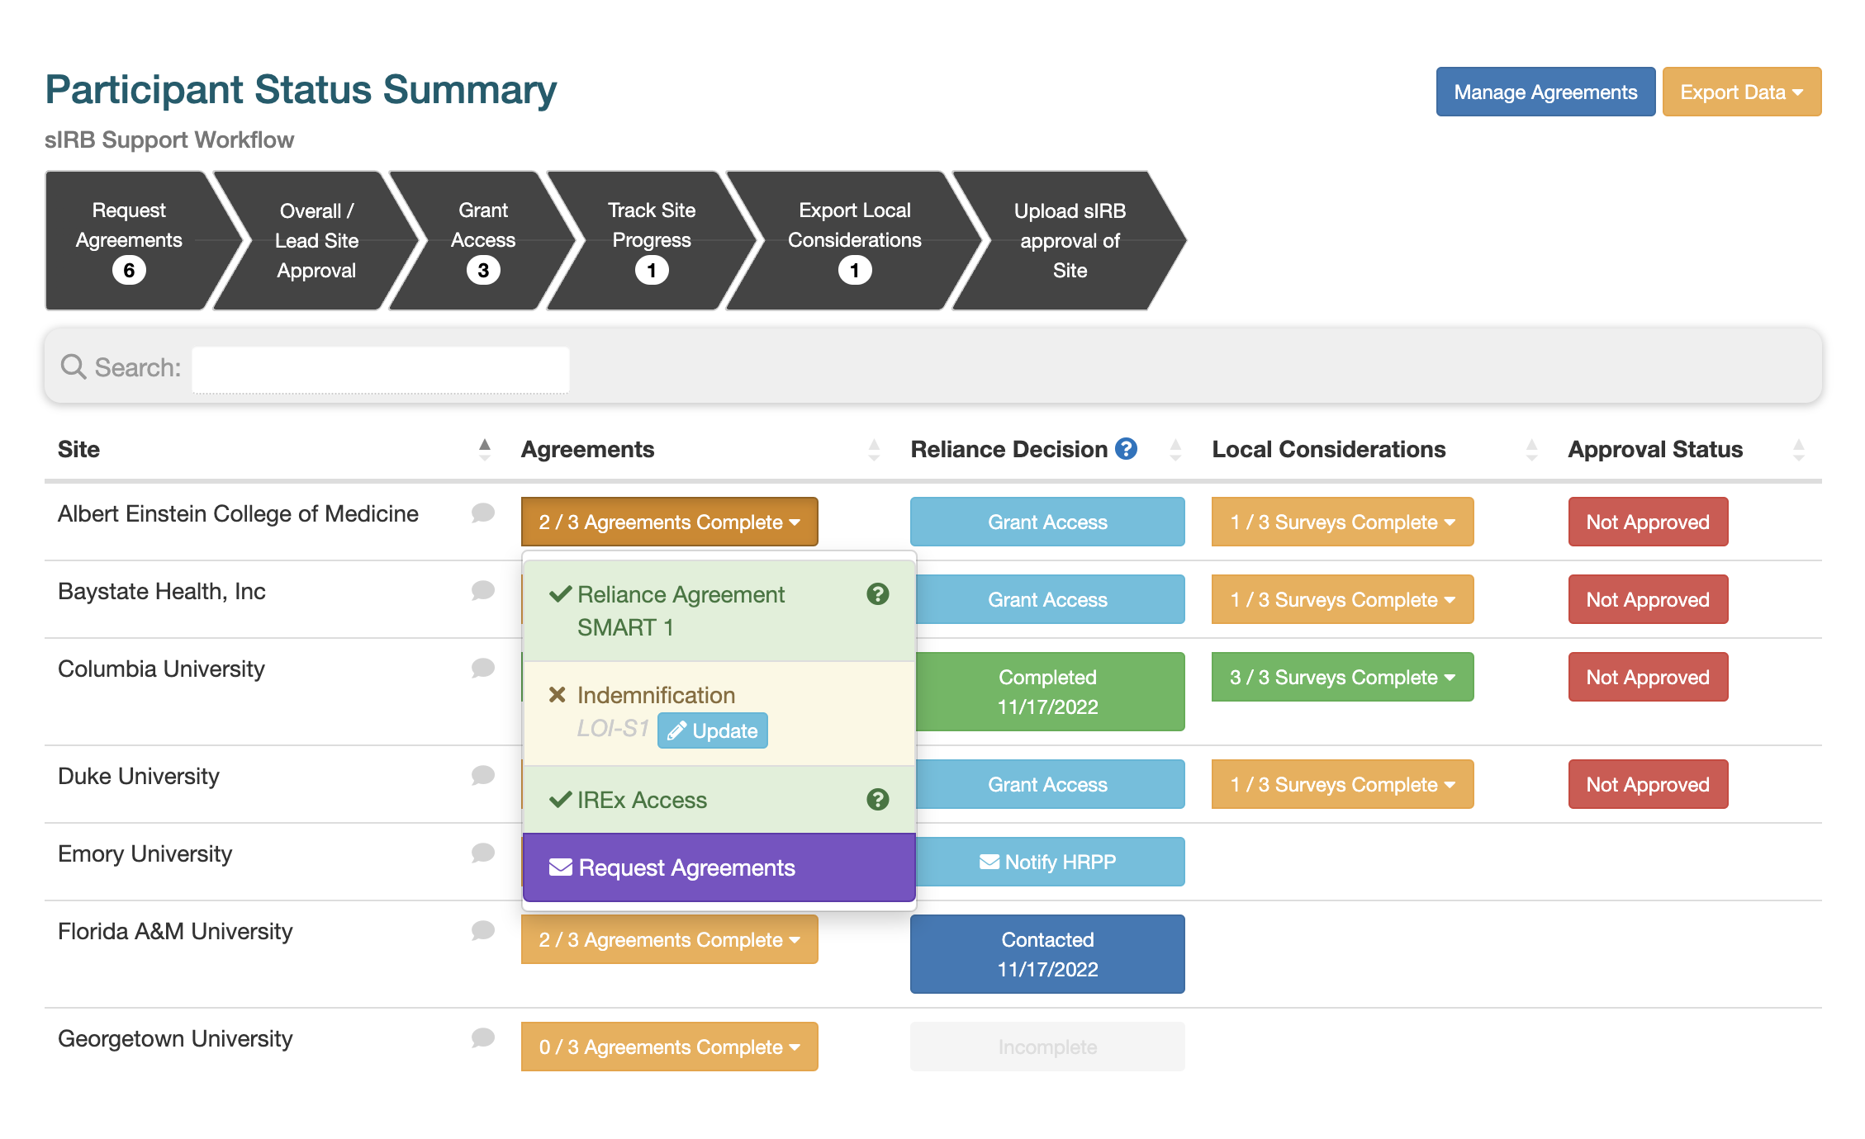
IREx Support for Lead Study Teams – Coming Soon!
Status Summary Tab Enhancements!
Onboarding workflow diagram
Indicators of # sites are in each step
Batch operations (grant access to a group / all sites)

Slide 18
You’re convinced to give IREx a try, right? Quick Demo: Creating a study in IREx

Slide 19
And even better than manually creating a study
IREX API allows sIRBs to
Push a study shell to IREx from the eIRB system
Push the Overall / lead site approval to IREx
Pull PSite reliance and local considerations documents from IREx to the eIRB system
Push PSite approvals to IREx
Push ongoing study approvals to IREx for the overall study & relying sites
Continuing reviews
Study wide amendments
Site amendments
Closures

Slide 20
Ongoing Efforts to Evaluate IREx & the sIRB Process
Satisfaction Survey Initiative
SM focus groups

Slide 21
Training Opportunities
https://www.irbexchange.org/p/sign-up-for-training/

